Slide 1



Unit 4
Machine Learning

Slide 2
Chapters for Discussion
Chapter - 1
Dimensionality Reduction Techniques (PCA)
Chapter - 2
DBSCAN
Chapter - 3
Ensemble Machine learning models

Slide 3

Chapter
DBSCAN
2

Slide 4


DISCLAIMER
The content is curated from online/offline resources and used for educational purpose only.

Slide 5

Learning Objectives
DBSCAN Clustering:
Understand concept of DBSCAN
Different types of Points in DBSCAN
GOAL

Slide 6
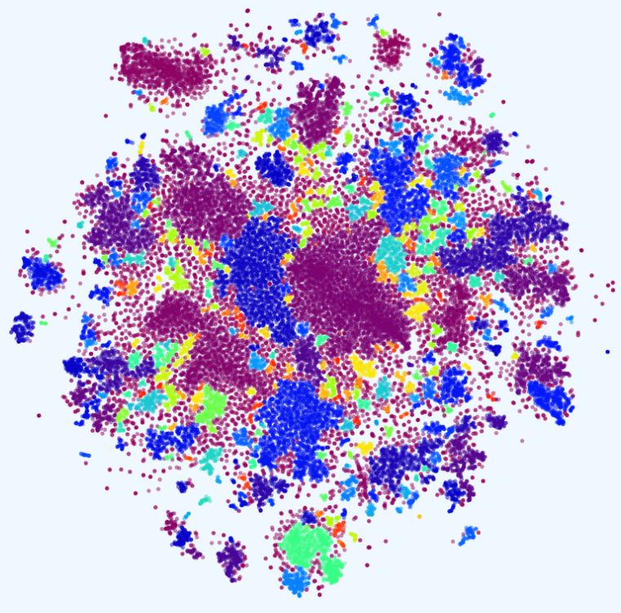
Introduction
DBSCAN (Density-Based Spatial Clustering of Applications with Noise) is a clustering algorithm that identifies clusters based on point density, handling arbitrary shapes and noise. It uses two parameters: eps (neighborhood radius) and MinPts (minimum points to form a cluster). This makes DBSCAN ideal for discovering complex cluster structures and managing outliers.
DBSCAN clustering image

Slide 7
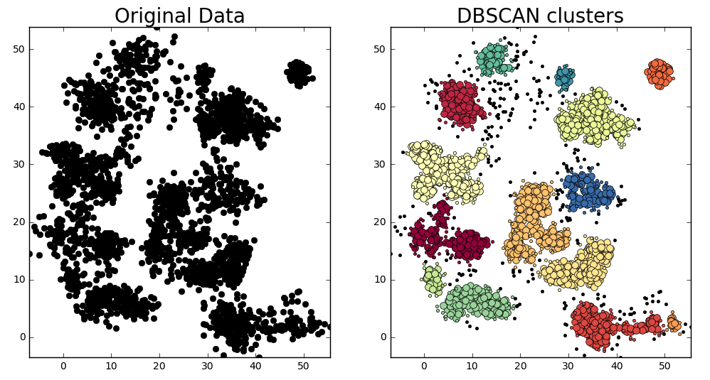
What is DBSCAN Clustering?
DBSCAN is a powerful clustering algorithm designed to identify clusters and noise within a dataset. It is particularly effective for data with irregular shapes and noise, unlike other methods that may struggle with such complexities.
.

Slide 8
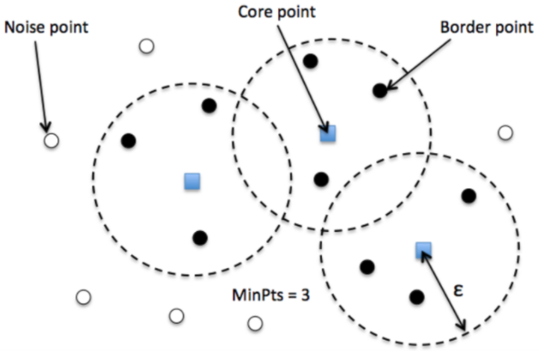
Key Concepts
Clusters: Dense regions in the data space.
Noise: Points that do not belong to any cluster.
Core Point: A point with at least MinPts neighbors within a radius eps.
Border Point: A point with fewer than MinPts neighbors but within the neighborhood of a core point

Slide 9
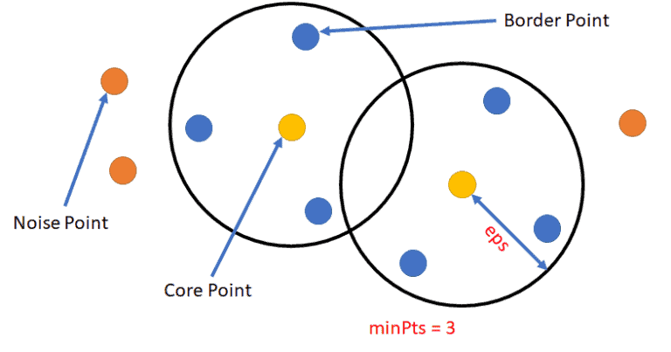
Parameters Required for DBSCAN Algorithm
eps (Epsilon): Defines the neighborhood radius around a data point. Points within this radius are considered neighbors. A small eps may label many points as noise, while a large eps may merge distinct clusters.
MinPts: The minimum number of points required to form a dense region. It should be chosen based on the dataset size, with a general rule of MinPts >= D + 1, where D is the number of dimensions.
Diagram depicting eps and MinPts

Slide 10
Steps in the DBSCAN Algorithm
Identify Core Points: For each point, find neighbors within eps and identify core points.
Form Clusters: For each core point not yet assigned to a cluster, create a new cluster.
Expand Clusters: Recursively find all density-connected points and assign them to the same cluster.
Mark Noise Points: Points that do not belong to any cluster are labeled as noise.

Slide 11
DBSCAN vs. K-Means Clustering
DBSCAN | K-Means
Does not require the number of clusters to be specified. | Sensitive to the specified number of clusters.
Can identify clusters of arbitrary shapes. | Forms spherical or convex clusters.
Handles noise and outliers well. | Poor performance with outliers.
Requires two parameters: eps and MinPts. | Requires one parameter: the number of clusters.

Slide 12
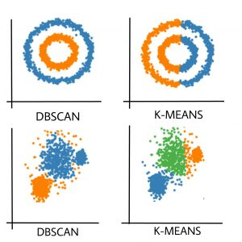
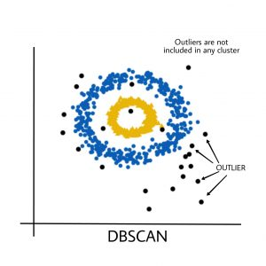
DBSCAN vs. K-Means Clustering
Reference

Slide 13

Lab Activity
Hands On
Lab 1
Implementing DBSCAN Algorithm
Notes:
GitHub Link – https://github.com/Code-Unnati/Advance-Course/tree/master/Module-1/Unit-3/Unit%203.2
Download all the files.
Let’s begin with the first lab - Implementing K-means Algorithm.

Slide 14

Conclusion
Hierarchical clustering and DBSCAN:
Hierarchical Clustering groups similar data points into clusters without predefined labels; used in unsupervised machine learning.
Agglomerative Clustering starts with each data point as an individual cluster and merges them into larger clusters.
Divisive Clustering begins with all data points in one cluster and splits them into smaller clusters.
DBSCAN is an unsupervised algorithm which identifies clusters and noise based on data density.

Slide 15
Reference
https://en.wikipedia.org/wiki/Unsupervised_learning
https://scikit-learn.org/stable/unsupervised_learning.html
http://cs229.stanford.edu/notes2020spring/cs229-notes8.pdf
https://developers.google.com/machine-learning/clustering
https://archive.ics.uci.edu/ml/index.php\
https://towardsdatascience.com/tagged/unsupervised-learning
k- Means Clustering. Don’t get confused with KNN. | by Siddhraj Maramwar | Analytics Vidhya | Medium
k- Means Clustering. Don’t get confused with KNN. | by Siddhraj Maramwar | Analytics Vidhya | Medium
Kriegel, Hans-Peter; Schubert, Erich; Zimek, Arthur (2016). "The (black) art of runtime evaluation: Are we comparing algorithms or implementations?". Knowledge and Information Systems. 52 (2): 341–378. doi:10.1007/s10115-016-1004-2. ISSN 0219-1377. S2CID 40772241.
https://www.analyticsvidhya.com/blog/2020/09/how-dbscan-clustering-works/
https://www.kdnuggets.com/2020/04/dbscan-clustering-algorithm-machine-learning.html
https://scikit-learn.org/stable/modules/generated/sklearn.cluster.DBSCAN.html
Notes:
Dear students Here are the references used to create the material for the study purpose only
Good bye everyone have a nice day.
15

Slide 16


Let’s Start

Slide 17


Quiz
1. What is the aim of DBSCAN??
To find similar groups of data
To determine the optimal Eps parameter
To create clusters by putting edges between points
To produce different results based on the data
Answer: B
To determine the optimal Eps parameter

Slide 18
Quiz
2. What is an advantage of DBSCAN?
It can produce different results based on the data
It is resistant to noise
It is used for supervised classification
It is used for pre-processing
Answer: B
It is resistant to noise

Slide 19
Quiz
3. What type of clustering is DBSCAN?
Density-based
Distance-based
Hierarchical
K-means
Answer: A
Density-based

Slide 20
Thank You
Notes:
Thank You !!

